Slide 1
Index Image Finger Tracking: Final Presentation
Eric Bowers and Daniel Zielenski
April 20, 2014

Slide 2
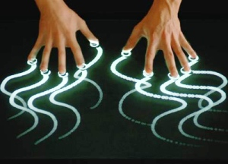
What We Were Hoping
Produce Image of object drawn with finger
Do this by creating an algorithm that helps track motion

Slide 3

What Went Wrong
Difficulties with Mouse
Difficult GUI
Camera Synching
Coding Errors/Crashes
Callback/Sequence Errors

Slide 4
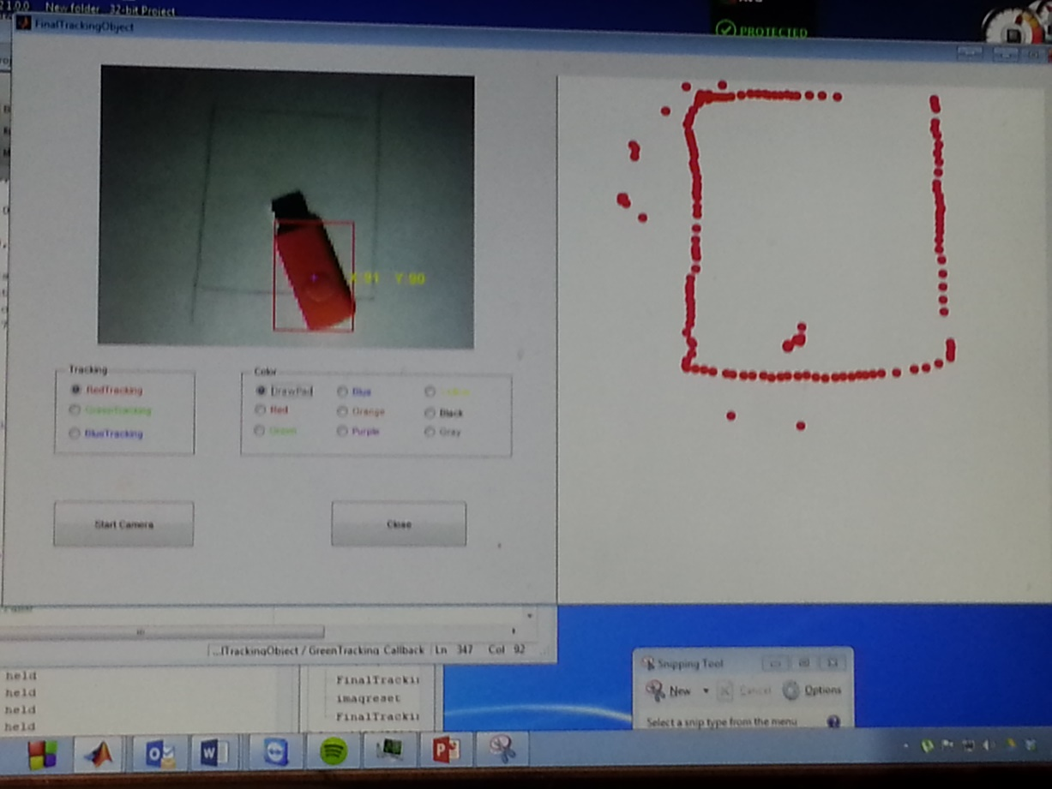
Breakthrough!

Slide 5
Why Did It Work?
While loops for continuous camera feeds
Separate functions to change the color
While loops(again) for tracking specific colors
Median filters, rgb2gray, binary filters and imsubtract to extract components of the chosen color
Nested if-else statements for when a color is picked
For loop to group the color objects around rectangular box with the coordinate of X and Y.

Slide 6
Reference
http://www.mathworks.com/matlabcentral/fileexchange/40154-how-to-detect-and-track-red--green-and-blue-colored-object-in-live-video
http://www.mathworks.com/matlabcentral/fileexchange/index?term=tag%3A%22red+object+detection%22
http://www.mathworks.com/matlabcentral/fileexchange/41014-virtual-painting

Slide 7

Questions?

